Slide 1


Notes:
Image source:
Git - https://git-scm.com/downloads/logos
GitHub - https://github.com/logos

Slide 2
What is Git?
Version Control System (VCS) for tracking changes in source code
during software development.
Distributed VCS
Coordinate work among developers
Used to track changes in any set of files
Access to local and remote repositories via VC platforms
Notes:
Promotes collaboration – doesn’t matter where in the world you are

Slide 3
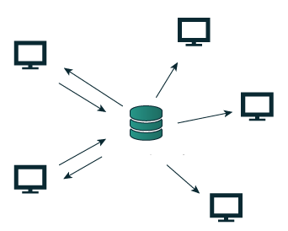
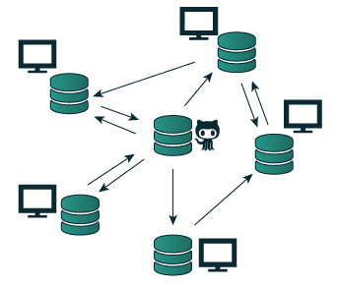
Centralised vs Distributed VCS
Notes:
Git is a distributed version control system
Examples of centralised version control systems are CVS and Subversion – still used heavily within the industry
There is a single, (centralised) master copy of the code base, and pieces of the code
that are being worked on are typically locked, (or “checked out”) so that only one developer is allowed
to work on that part of the code at any one time
There is still a master copy of the code base, but it is kept on a client machine rather than
a server. There is no locking of parts of the code; developers make changes in their
local copy and then, once they’re ready to integrate their changes into the master copy
Distributed – you get your own repository when you clone the project
You can work and add code to the repository even when offline, since the repository lives on your computer locally
Centralised means that the code lives on a server – everything lives in one place
Developers need special permissions to be able to add code to the repository

Slide 4
Core concepts of Git
Keeps track of your source code history
Takes snapshots of your source code files
You decide when to take the snapshot – “commit”
You can stage files before committing – “add”
You can visit any snapshot at anytime
Notes:
Every time you are making a commit to a Git repository, you are saving a snapshot of all the files in your repository or
Taking a snapshot of your source code at its current state

Slide 5
Basic commands
Command | Description
git init | Initialise local Git repository
git add <file> | Add file(s) to index
git status | Check status of working tree
git commit | Commit changes in index
git push | Push to remote repository
git pull | Pull latest from remote repository
git clone | Clone repository into a new directory

Slide 6
Installing Git
Cross platform
Windows – https://git-scm.com/download/win
Mac OS X – https://git-scm.com/download/mac
Linux – sudo apt-get install git
Notes:
Git is already installed on the OP computers

Slide 7
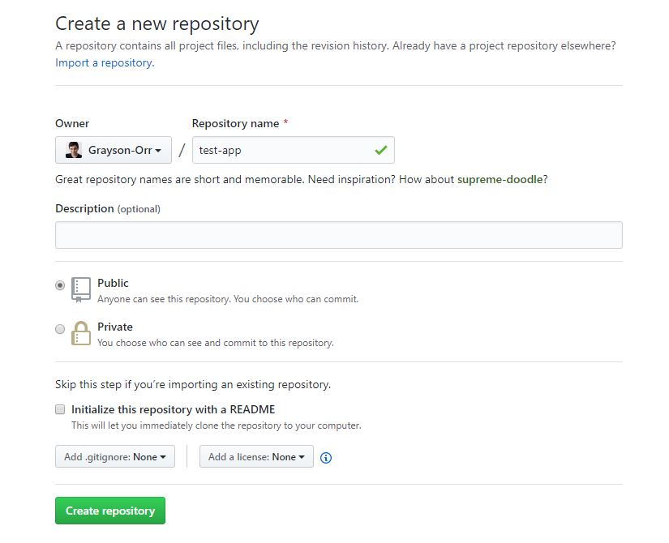
Creating a new repository
Notes:
Go to GitHub and either create new account or login
On the left-hand side on your homepage there is a bright green button called “New”
Click on the button and you will be redirected to this page
Fill out the mandatory field and click the “Create repository” button

Slide 8
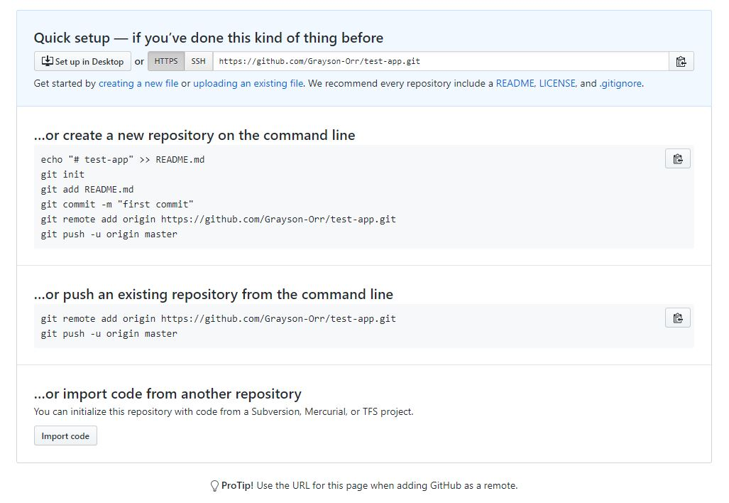
Cloning a repository
Notes:
Copy this URL – this is the link to your remote repository

Slide 9
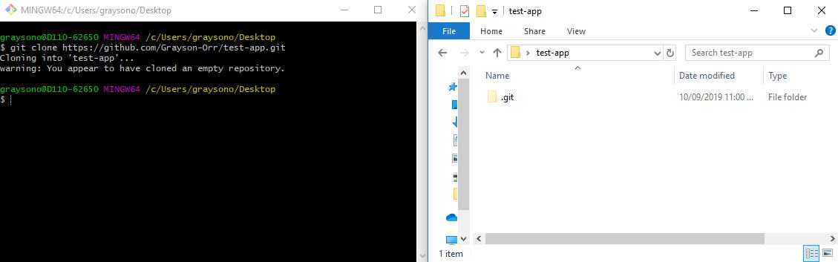
Cloning a repository
Notes:
You have cloned an empty repository – most of the time this won’t be empty
.git is a hidden directory

Slide 10
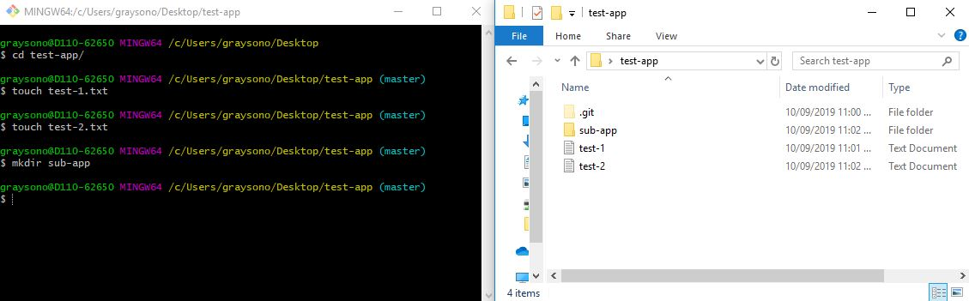
Add files/directories to the repository
Notes:
We aren’t going to go through the concepts of branches, but we are currently on the master branch (default)
Change directory into test-app
Create two files called test-1.txt and test-2.txt – in Linux we use the touch command. Of course, you can manually do this
Create an empty directory call sub-app – don’t put any files in here

Slide 11
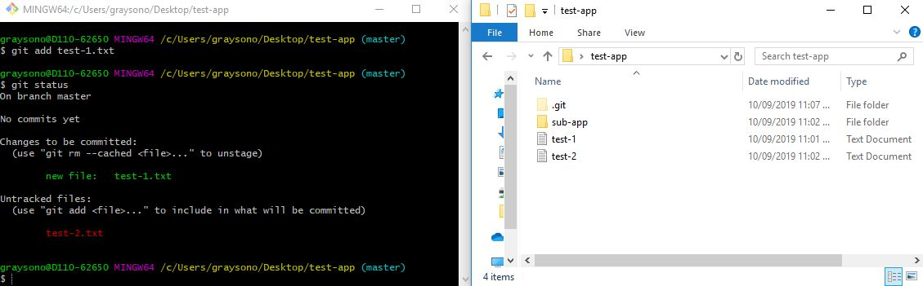
Staging files
Notes:
Now we have files to play with…lets add them to our staging area or the index
If we explicitly type git add test-1.txt, we are add this file to the staging area ready for committing
We can of course remove this file if we don’t want to commit it – type git rm –cached <file>
The best thing about Git is the messages – git status is a very handle command
No commits yet…

Slide 12
Alternative git add commands
Command | Description
git add . | Add all changed files in the current directory and subdirectories
git add * | Add all changed files in the working tree
git add –A/--all | Add all changed files in the working tree
git add –u/--update | Add all modified/deleted files but not new files in the working tree
Notes:
There are other commands that we can use to add a file or files to the staging area
Changed files – new, modified and deleted files

Slide 13
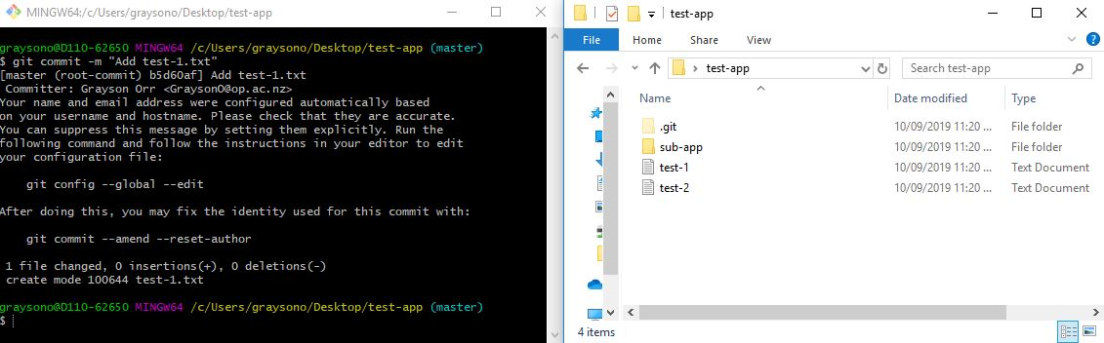
Committing staged files
Notes:
To commit staged file(s), we can type git commit –m “<message>”
The –m flag means message
Make sure that you have enclosed your message in double quotes
The HEAD – points to the last commit you have made

Slide 14
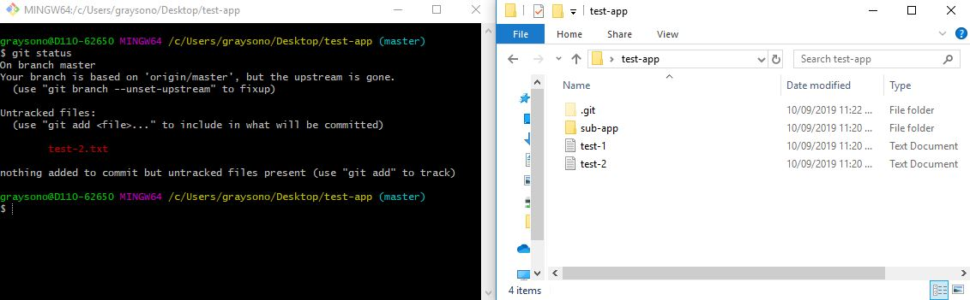
Check status of committing files
Notes:
Familiarise yourself with the statuses – this example doesn’t tell us much
You can almost guarantee there are no conflicts

Slide 15
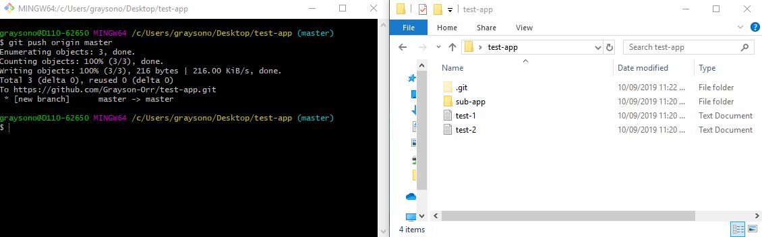
Pushing our committed files
Notes:
Last and the most important step is pushing our committed file(s) to the remote repository
We can type git push or if we want to be safe git push origin master

Slide 16
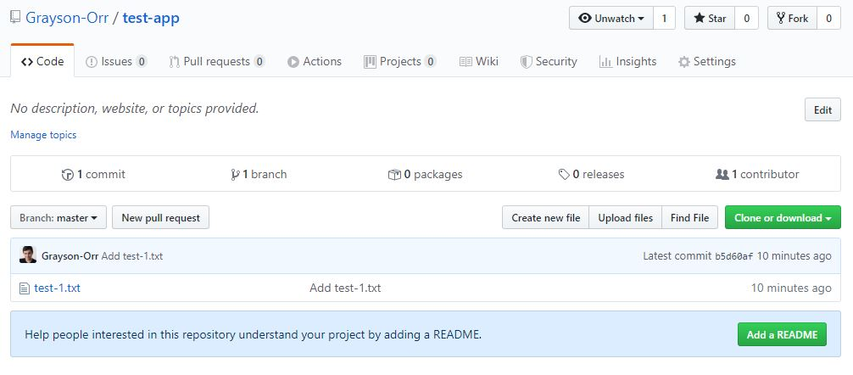
Check your GitHub repository
Notes:
If we go back to GitHub and refresh the page we will see the file(s) in our remote repository
We can create new files and upload existing files, but unfortunately we can’t do this with directories

Slide 17
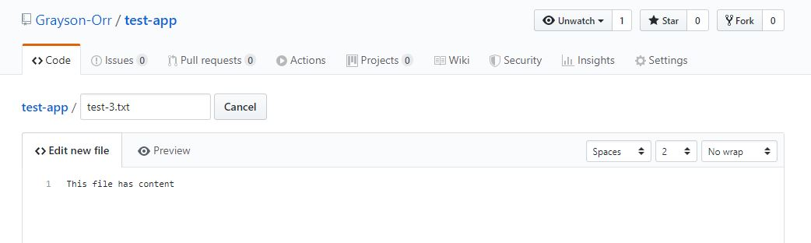
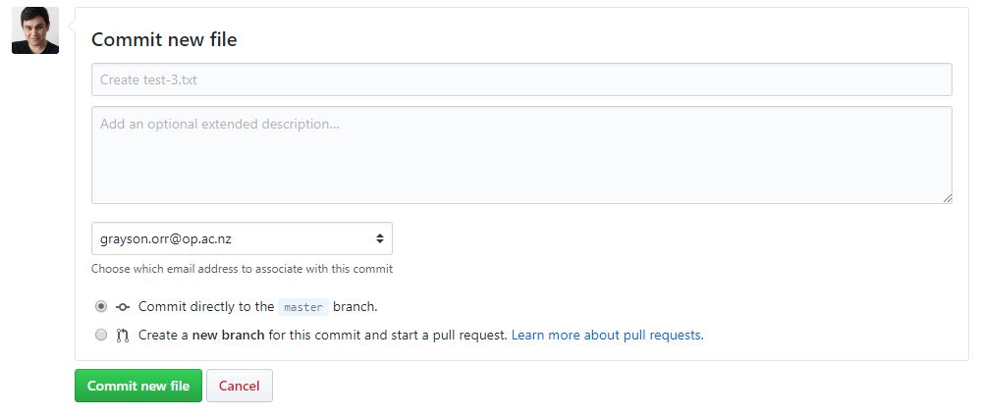
Pulling files from the remote repository
Notes:
Click the “Create new file” button
Create a new file with an appropriate extension name – my example is test-3.txt
Add content if you want
Scroll to the bottom and click on the bright green “Commit new file” button
This will commit directly to the master branch

Slide 18
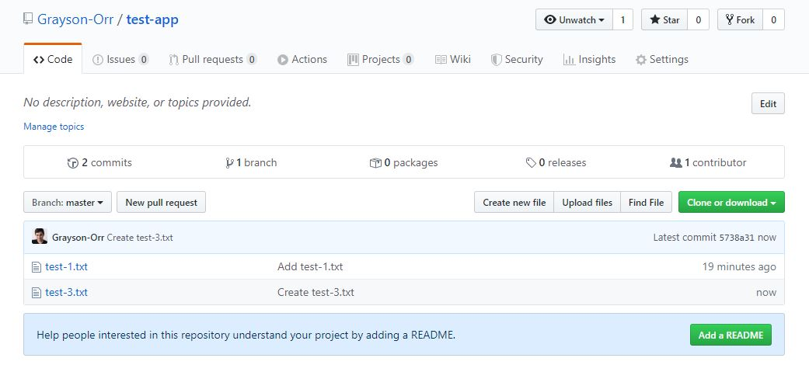
Pulling files from the remote repository
Notes:
You have new file called test-3.txt in your remote repository
How do I get this into my local repository???

Slide 19
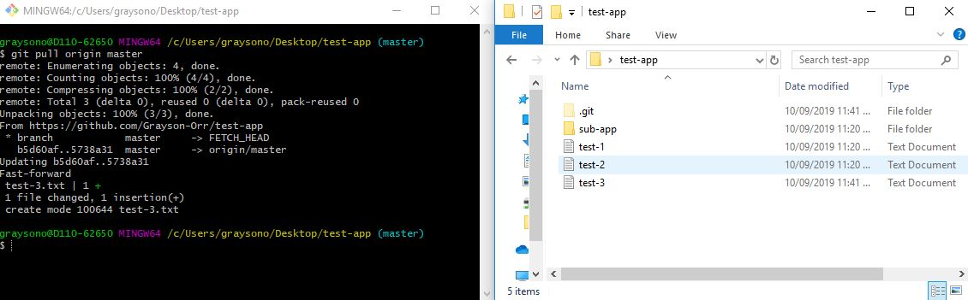
Pulling files from the remote repository
Notes:
Initially you won’t see test-3.txt until you run the correct command
To pull files from your remote repository, we can type git pull or if we want to be safe git pull origin master
You should now see test-3.txt in your local repository

Slide 20
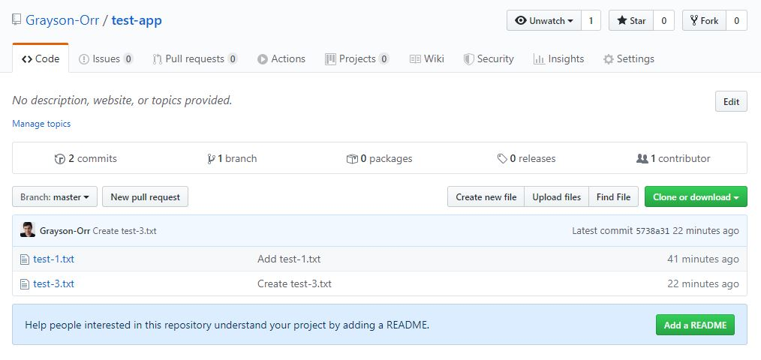
Track changes
Notes:
We can track changes on this repository by click on “# commits”
The # represents the number of commits made to this branch

Slide 21
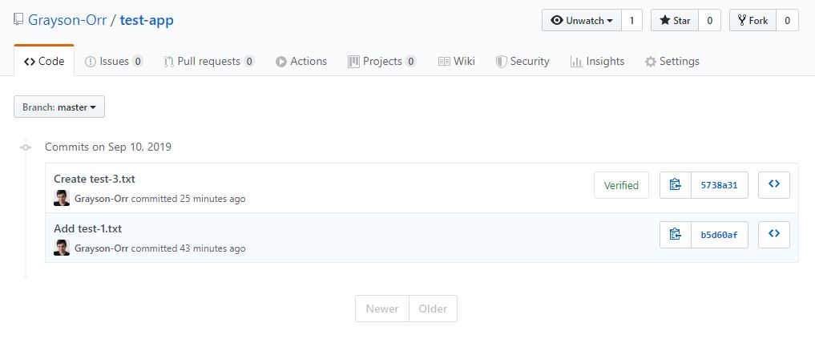
Track changes
Notes:
Here we can view our remote repositories commit history
Information includes:
The commit message
The commit author
The commit time
The file changes
The repository at this point in time

